Slide 1


4
Creating Your Own Classes
C# Programming: From Problem Analysis to Program Design
4th Edition

Slide 2
Chapter Objectives
Become familiar with the components of a class
Learn about the different methods and properties used for object-oriented development
Create and use constructors
Write your own instance methods to include mutators and accessors
Call instance methods including mutators and accessors
Work through a programming example that illustrates the chapter’s concepts

Slide 3
The Object Concept
Solution is defined in terms of a collection of cooperating objects
Class serves as template from which many objects can be created
Abstraction
Attributes (data)
Behaviors (processes on the data)

Slide 4
Private Member Data
All code you write is placed in a class
When you define a class, you declare instance variables or fields that represent state of an object
Fields are declared inside the class, but not inside any specific method
Fields become visible to all members of the class, including all of the methods
Data members are defined to have private access

Slide 5
Private Member Data (continued)
public class Student
{
private int studentNumber;
private string studentFirstName;
private string studentLastName;
private int score1;
private int score2;
private int score3;
private string major;

Slide 6
Add a Class
Use the PROJECT menu or the Solution Explorer Window
Right-mouse click and select the option Add, Class
Solution Explorer Window enables you to create a class diagram

Slide 7
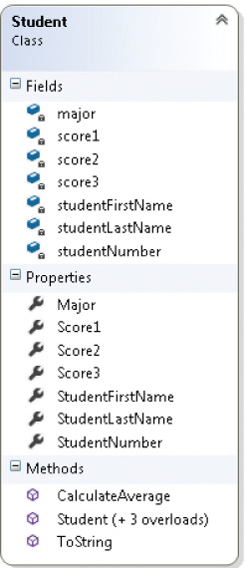
Class Diagram
Open the Class Diagram from Solution Explorer, View Class Diagram
Figure 4-1 Student class diagram created in Visual Studio

Slide 8
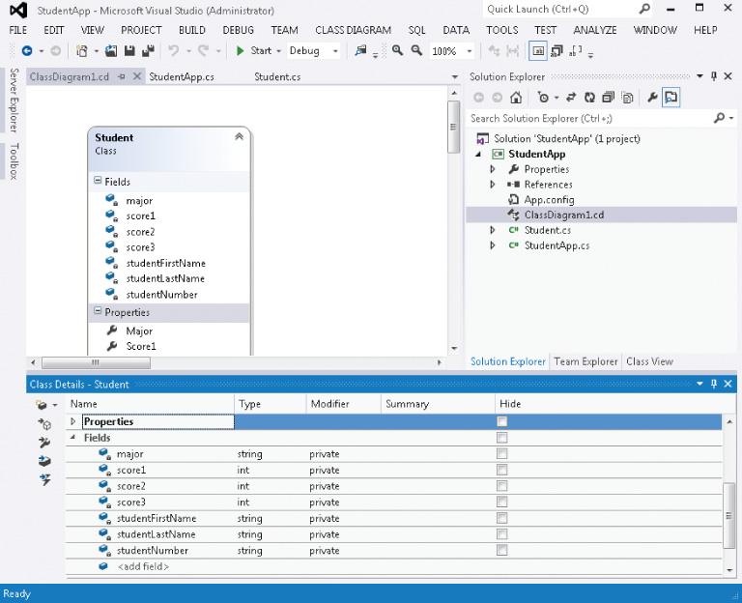
Class Diagram (continued)
After the class diagram is created, add the names of data members or fields and methods using the Class Details section
Right click on class diagram to open Class Details window
Figure 4-2 Student class diagram details

Slide 9
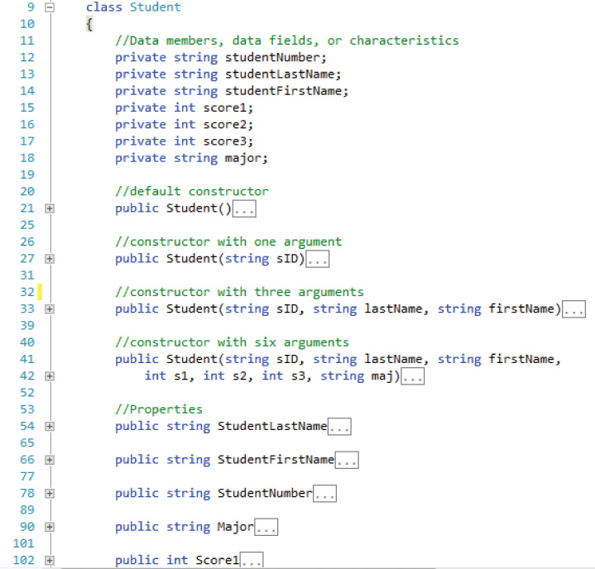
Class Diagram (continued)
When you complete class details using the Class Diagram tool, code is automatically placed in the file.
Figure 4-3 Auto generated code from Student class diagram

Slide 10
Constructor
Special type of method used to create objects
Create instances of class
Instantiate the class
Constructors differ from other methods
Constructors do not return a value
Also do not include keyword void
Constructors use same identifier (name) as class
Constructors use public access modifiers

Slide 11
Constructor (continued)
public access modifier is always associated with constructors
//Default constructor
public Student ( )
{
}
//Constructor with one parameter
public Student (int sID )
{
studentNumber = sID;
}

Slide 12
Constructor (continued)
//Constructor with three parameters
public Student (string sID, string firstName, string lastName)
{
studentNumber = sID;
studentFirstName = firstName;
studentLastName = lastName;
}
Design classes to be as flexible and as full-featured as possible
Include multiple constructors

Slide 13
Writing Your Own Instance Methods
Constructors
Accessors
Mutators
Other methods to perform behaviors of the class

Slide 14
Writing Your Own Instance Methods
Do not use static keyword
Static associated with class method
Constructor – special type of instance method
Do not return a value
void is not included
Same identifier as the class name
Overloaded
Default constructor
No arguments
Write one constructor and you lose the default one

Slide 15
Accessor
Getters
Returns the current value
Standard naming convention → prefix with “get”
Accessor for noOfSquareYards
public double GetNoOfSqYards( )
{
return noOfSqYards;
}
Properties serve purpose
Accessor

Slide 16
Mutators
Setters
Normally includes one parameter
Method body → single assignment statement
Standard naming convention → prefix with ”Set”
Can be overloaded

Slide 17
Mutator Examples
public double SetNoOfSqYards(double squareYards)
{
return noOfSquareYards;
}
public void SetNoOfSquareYards(double length, double width)
{
noOfSquareYards = squareYards;
}
Mutator
Overloaded

Slide 18
Other Instance Methods
No need to pass arguments to these methods –
Defined in the same class as the data members
Instance methods can directly access private data members
Define methods as opposed to storing values that are calculated from other private data members
public double CalculateAverage( )
{
return (score1 + score2 + score3) / 3.0;
}

Slide 19
Property
Can replace accessors and mutators
Properties looks like a data field
More closely aligned to methods
Standard naming convention in C# for properties
Use the same name as the instance variable or field, but start with uppercase character
Doesn’t have to be the same name – no syntax error will be thrown

Slide 20
Property
public double NoOfSqYards
{
get
{
return noOfSqYards;
}
set
{
noOfSqYards = value;
}
}

Slide 21
Property (continued)
If an instantiated object is named berber, to change the NoOfSqYards, write:
berber.NoOfSqYards = 45;

Slide 22
ToString( ) Method
All user-defined classes inherit four methods from the object class
ToString( )
Equals( )
GetType( )
GetHashCode( )
ToString( ) method is called automatically by several methods
Write( )
WriteLine( ) methods
Can also invoke or call the ToString( ) method directly

Slide 23
ToString( ) Method (continued)
Returns a human-readable string
Can write a new definition for the ToString( ) method to include useful details
public override string ToString( )
{ // return string value }
Keyword override added to provide new implementation details
Always override the ToString( ) method
This enables you to decide what should be displayed if the object is printed

Slide 24
ToString( ) Example
public override string ToString( )
{
return "Price Per Square Yard: " +
pricePerSqYard.ToString("C") +
"\nTotal Square Yards needed: " +
noOfSqYards.ToString("F1") +
"\nTotal Price: " +
DetermineTotalCost( ).ToString("C");
}

Slide 25
ToString( ) method
Sometimes useful to add format specifiers as one of the arguments to the Write( ) and WriteLine( ) methods – Invoke ToString( )
Numeric data types such as int, double, float, and decimal data types have overloaded ToString( ) methods
pricePerSqYard.ToString("C")

Slide 26
Calling Instance Methods
Instance methods are nonstatic method
Call nonstatic methods with objects – not classes
Static calls to members of Math and Console classes
answer = Math.Pow(4, 2) Console.WriteLine( )
If you need to invoke the method inside the class it is defined in, simply use method name
If you need to invoke the method outside the class it is defined in, precede method name with object identifier
berber.GetNoOfSquareYards( )

Slide 27
Calling the Constructor
Normally first method called
Creates an object instance of the class
ClassName objectName = new ClassName(argumentList);
or
ClassName objectName;
objectName = new ClassName(argumentList);
Keyword new used as operator to call constructor methods
CarpetCalculator plush = new CarpetCalculator ( );
CarpetCalculator pile =
new CarpetCalculator (37.90, 17.95);

Slide 28
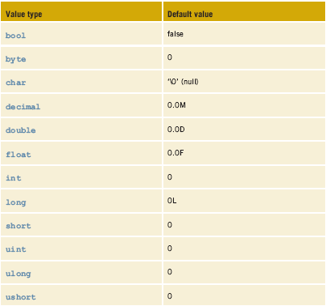
Constructor (continued)
Default values are assigned to variables of the value types when no arguments are sent to constructor
Table 4-1 Value type defaults

Slide 29
Calling Accessor and Mutator Methods
Method name is preceded by the object name
berber.SetNoOfSquareYards(27.83);
Console.WriteLine("{0:N2}", berber.GetNoOfSquareYards( ));
If property defined, can use property instead of accessor and/or mutators
Using properties
PropertyName = value; // Acts like mutator here
Console.Write("Total Cost at {0:C} ", berber.Price); // Acts like accessor here

Slide 30
Calling Other Instance Methods
Call must match method signature
If method returns a value, must be a place for a value to be returned
Student aStudentObject = new
Student("1234", "Maria", "Smith", 97, 75, 87, "CS");
average = aStudentObject.CalculateAverage( );
No arguments needed as parameters to the CalculateAverage( ) method. CalculateAverage( ) is a member of the Student class and has full access to all Student members.

Slide 31
Testing Your New Class
Different class is needed for testing and using your class
Test class has Main( ) in it
Construct objects of your class
Use the properties to assign and retrieve values
Invoke instance methods using the objects you construct

Slide 32
Calling the Constructor Method
Figure 4-4 Intellisense displays available constructors

Slide 33
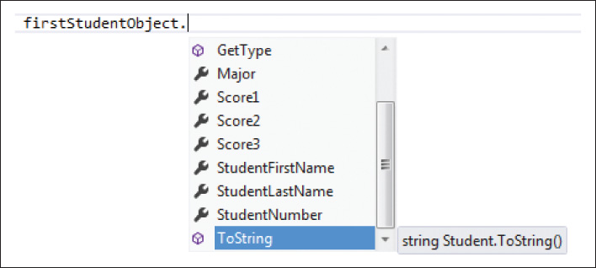
Using Public Members
Figure 4-5 Public members of the Student class

Slide 34
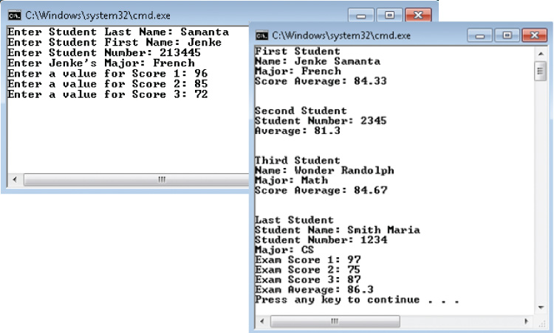
StudentApp
Figure 4-6 Output from
StudentApp
Review StudentApp Project

Slide 35
Test Class
With multiclass solutions all input and output should be included in the class that has the Main( ) method
Eventual goal will be to place your class files, like Student and CarpetCalculator, in a library so that the classes can be used by different applications
Some of these applications might be Windows applications; some may be console applications; others may be Web application
Do not include ReadLine( ) or WriteLine( ) in your class methods

Slide 36
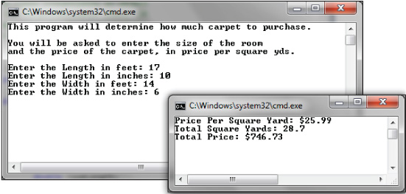
Testing Your New Class
Figure 4-7 Output from
Carpet example using
instance methods
Review CarpetCalculator Project

Slide 37
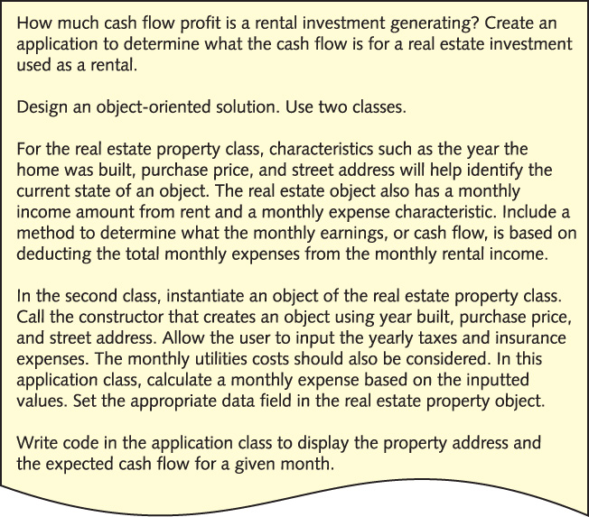
RealEstateInvestment Example
Figure 4-8 Problem specification for RealEstateInvestment example

Slide 38
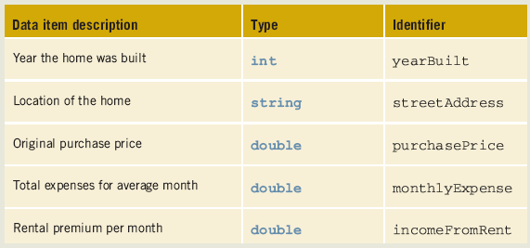
Data for the RealEstateInvestment Example
Table 4-2 Instance variables for the RealEstateInvestment class

Slide 39
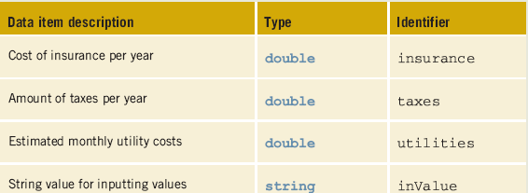
Data for the RealEstateInvestment Example (continued)
Table 4-3 local variables for the property application class

Slide 40
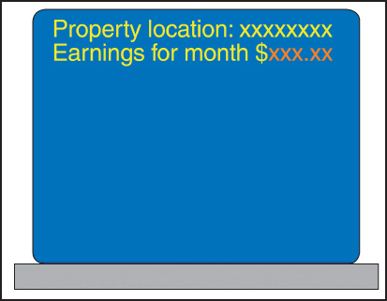
RealEstateInvestment Example (continued)
Figure 4-9 Prototype

Slide 41
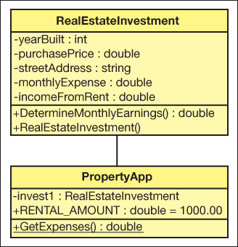
RealEstateInvestment Example (continued)
Figure 4-10 Class diagrams

Slide 42
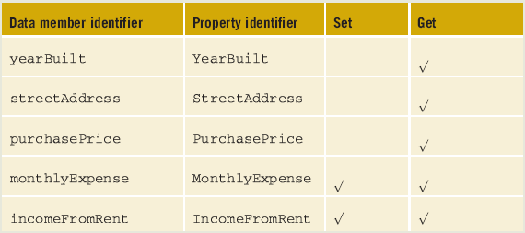
RealEstateInvestment Example (continued)
Table 4-4 Properties for the RealEstateInvestment class

Slide 43
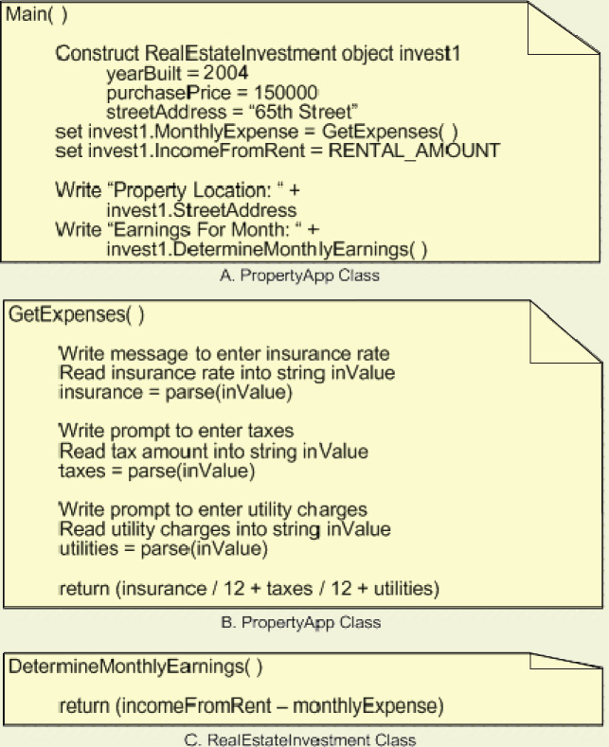
RealEstateInvestment Example (continued)
Figure 4-11 Structured
English for the
RealEstateInvestment
example

Slide 44
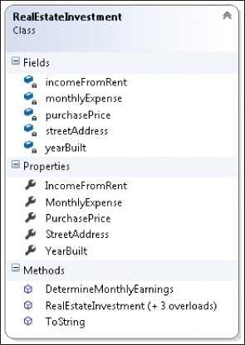
Class Diagram
Figure 4-12 RealEstateInvestment class diagram

Slide 45
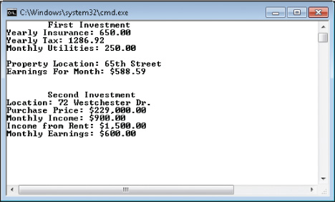
Test and Debug
Figure 4-13 Output from RealEstate Investment example
View RealEstateInvestment

Slide 46
Coding Standards
Naming Conventions
Classes
Properties
Methods
Constructor Guidelines
Spacing Guidelines

Slide 47
Resources
C# Coding Standards and Best Practices –
http://www.dotnetspider.com/tutorials/BestPractices.aspx
C# Station Tutorial - Introduction to Classes –
http://www.csharp-station.com/Tutorials/Lesson07.aspx
Object-Oriented Programming –
http://msdn.microsoft.com/en-us/library/dd460654.aspx
Introduction to Objects and Classes in C#
http://www.devarticles.com/c/a/C-Sharp/Introduction-to-Objects-and-Classes-in-C-sharp/

Slide 48
Chapter Summary
Components of a method
Class methods
Parameters
Predefined methods
Value- and nonvalue-returning methods

Slide 49
Chapter Summary (continued)
Properties
Instance methods
Constructors
Mutators
Accessors
Types of parameters

